Slide 1
Matlab-Based Antenna array Optimizer
B05901088 黃士銘

Slide 2
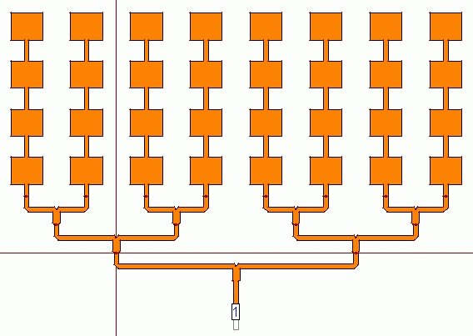
Guideline
An Antenna
The Importance of Antenna Array (陣列天線)
Key Component in 5G communication
Pattern (場型) of Antenna Array
Pattern of 2 sources and 1 source
Pattern Verification
Pattern of 2 sources with various distance
AI-Powered Pattern Optimizer
Block Diagram
Results
Conclusions
An Antenna Array

Slide 3
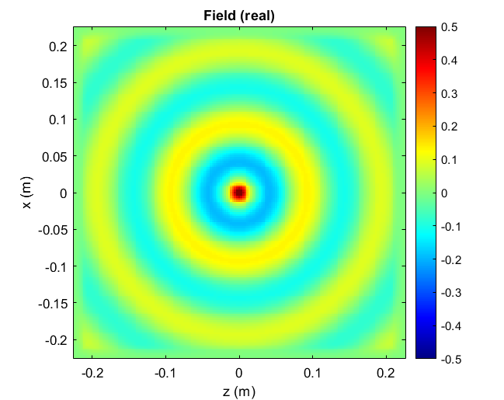
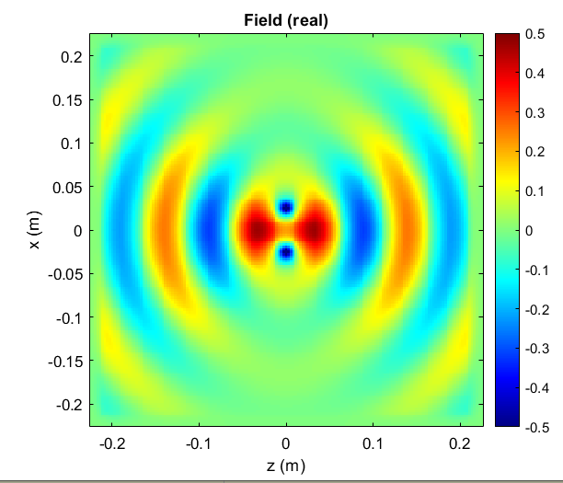
Guideline
The Importance of Antenna Array (陣列天線)
Key Component in 5G communication
Pattern (場型) of Antenna Array
Pattern of 2 sources and 1 source
Pattern Verification
Pattern of 2 sources with various distance
AI-Powered Pattern Optimizer
Block Diagram
Results
Conclusions
Single
Double

Slide 4
Guideline
The Importance of Antenna Array (陣列天線)
Key Component in 5G communication
Pattern (場型) of Antenna Array
Pattern of 2 sources and 1 source
Pattern Verification
Pattern of 2 sources with various distance
AI-Powered Antenna Array Optimizer
Block Diagram
Results
Conclusions

Slide 5
Importance of Antenna Array

Slide 6
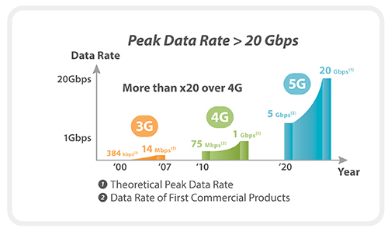
Potential of 5G

Slide 7
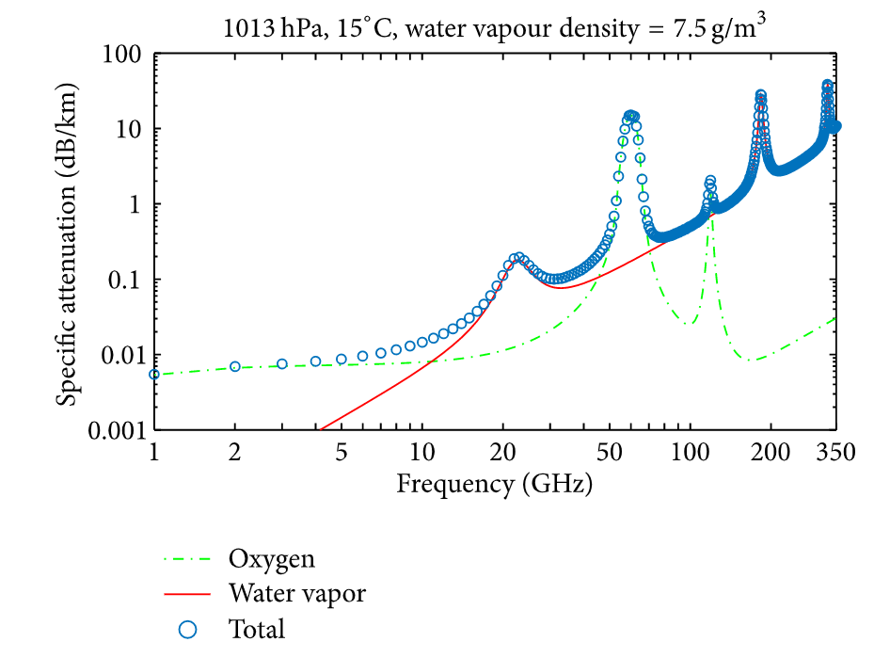
Antenna Array in 5G
w/o Antenna Array
with Antenna Array
4G
Wi-Fi
5G
Power Wasted
Power Concentration
1 band for 1 device
1 band for N devices

Slide 8
Pattern of Antenna Array

Slide 9
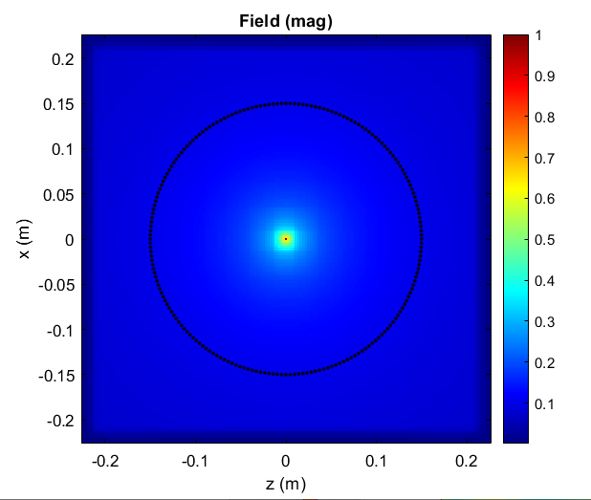
Single Isotropic Point Source
Waveform
Field Distribution

Slide 10
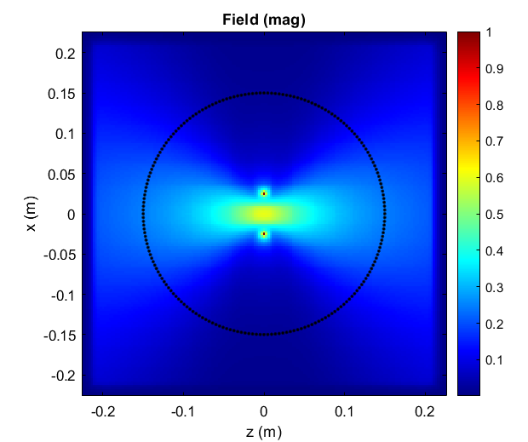
Two Isotropic Point Source (D = 0.5λ)
D
Waveform
Field Distribution

Slide 11
Single Sources v.s. Double Sources
B
A
A
B
Single
Double

Slide 12
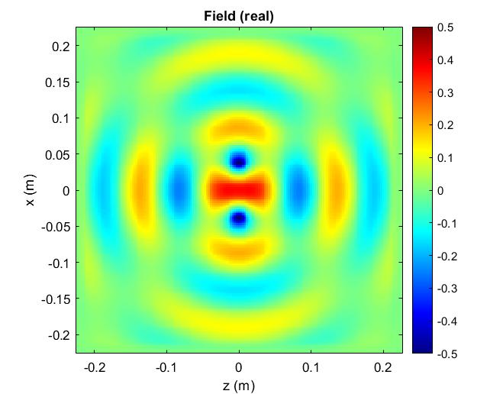
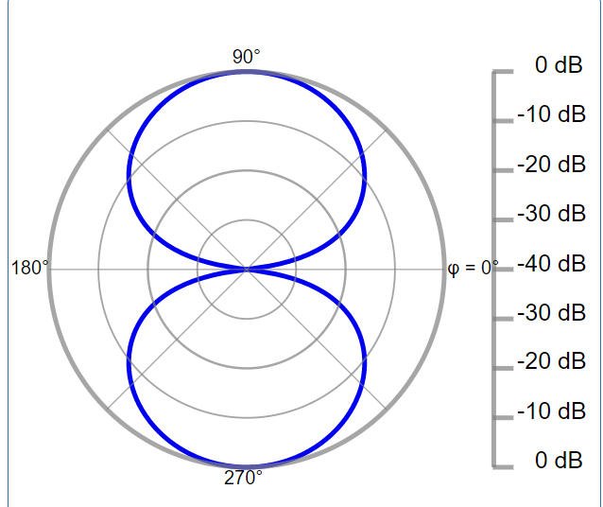
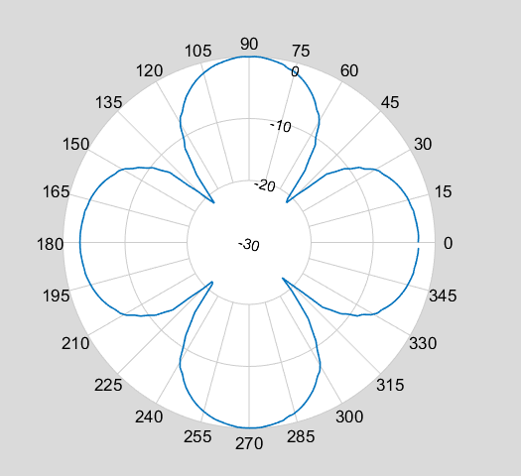
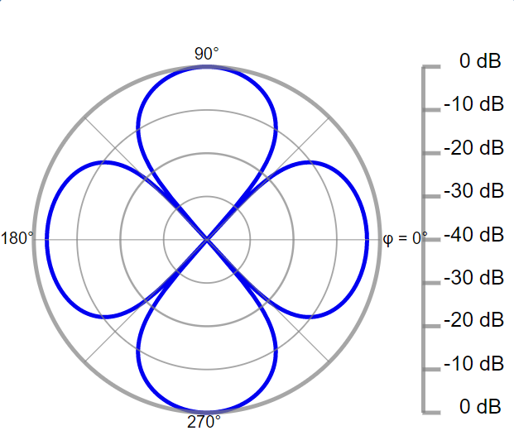
Double Sources (Verification)
$$d=0.5λ$$
$$d=0.75λ$$
My Work
Analytical
My Work
Analytical
Reference: http://em.emedu.org.tw/elec_sim/9-4.html

Slide 13
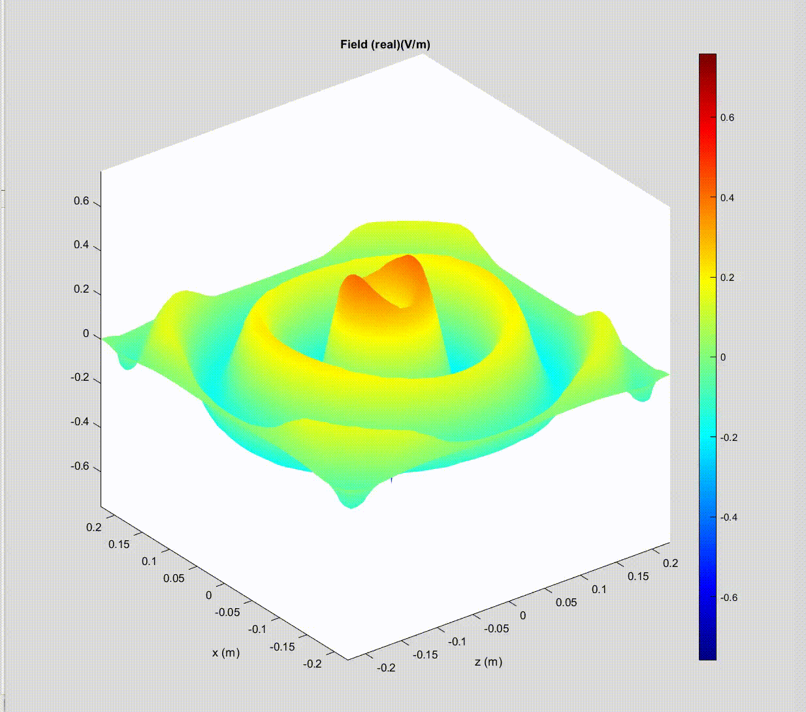
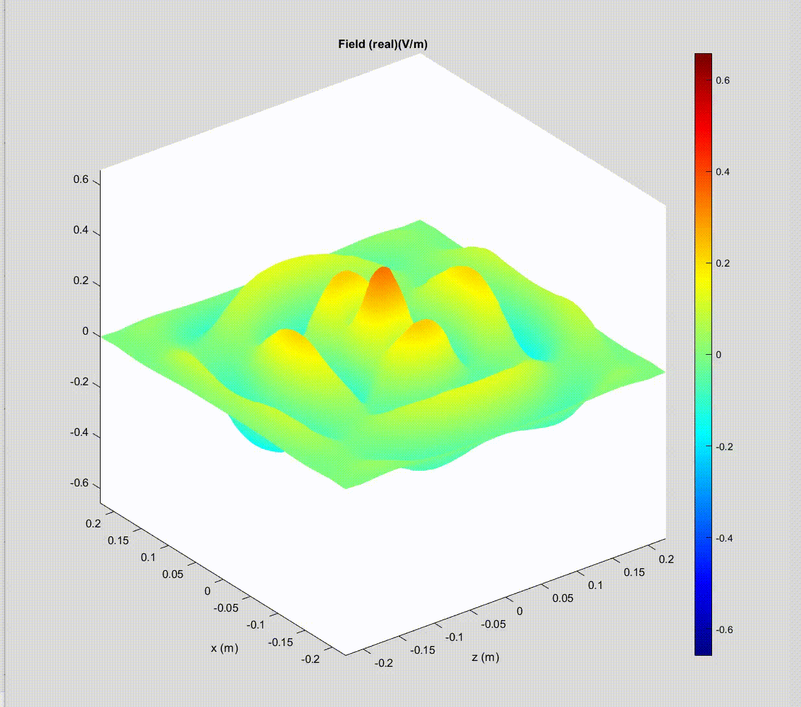
Double Sources with various Distance
D
D = 0.25 $λ$
D = 0.5 $λ$
D = 0.75 $λ$

Slide 14
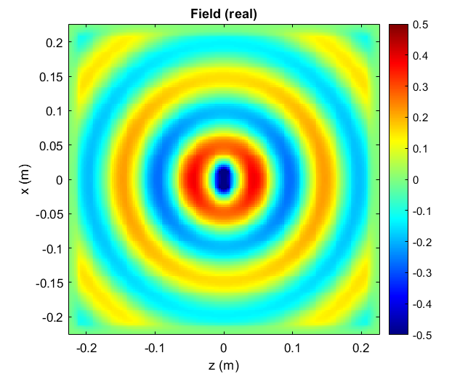
Double Sources with various Distance
D
D = 0.25 $λ$
D = 0.5 $λ$
D = 0.75 $λ$
Best Design ?

Slide 15
AI-Powered Antenna Array Optimizer

Slide 16
Block Diagram
Request an array parameter
Randomly Synthesize a Pattern
Do Optimization
Max(Directivity)
Good
Bad

Slide 17
Max(Directivity)
High Directivity
$$Directivity=(\frac{Power_{max}}{Power_{avg}} )$$
Low Directivity

Slide 18
Results
D

Slide 19
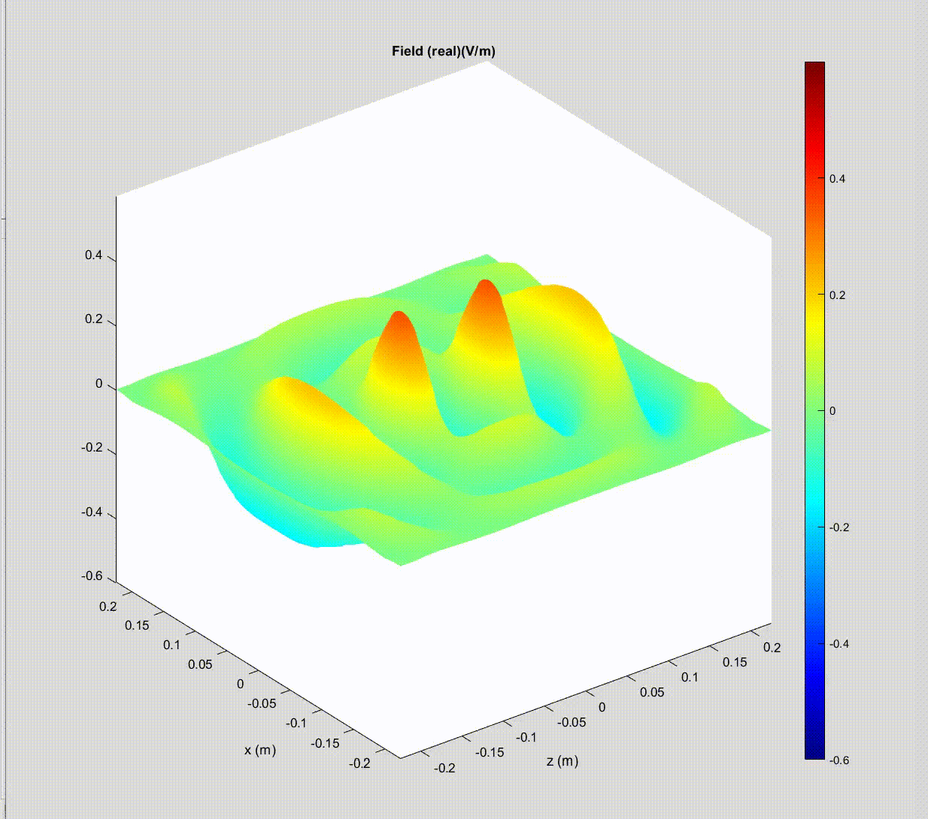
Results
D = 0.5 $λ$ (Pre Opt.)
D = 0.6016 $λ$(Post Opt.)

Slide 20
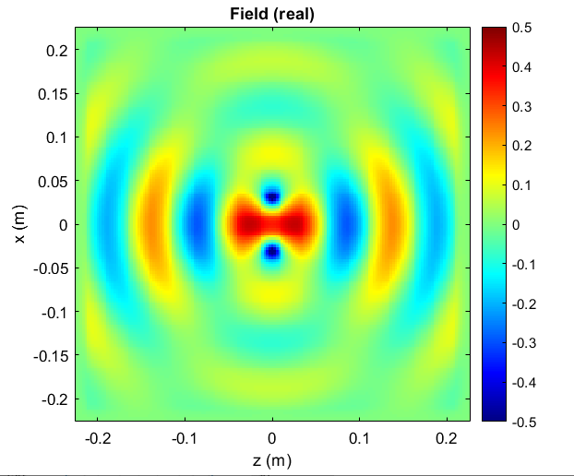
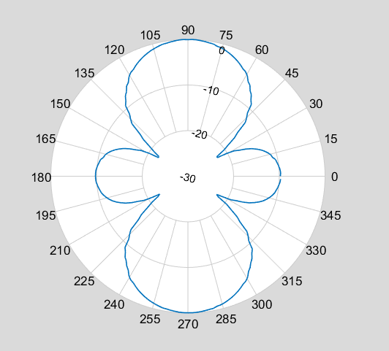
Results
D = 0.5 $λ$ (Pre Opt.)
D = 0.6016 $λ$(Post Opt.)
Directivity = 2.8388
Directivity = 3.2681

Slide 21
Conclusion
Antenna Array is an essential part of 5G Communications
Matlab-based 2D FEM solver is verified by analytical solution
AI-Powered Antenna Array Optimizer is proved effective

